Slide 1
Innovative Germany
© DAAD/Jan Zappner
Status: March 2026
Status: Septembre 2025
Notes:
This information has been prepared by:
Section International Research Marketing
research-in-germany@daad.de
German Academic Exchange Service (DAAD)
Kennedyallee 50
53175 Bonn
www.daad.de/en
Updated/edited: 04/2026
Important information about using the “Research in Germany” presentations:
All the images, logos, charts and similar elements contained in the “Research in Germany” presentations may be used solely for the purposes of the presentation. Any removal or reuse of this content for other purposes is not permitted.
The presentations may be passed on to listeners solely in non-editable form. In other words, the presentations can be made available for example in PDF format or in the form of a video that can be accessed via the following YouTube link: https://www.youtube.com/watch?v=sywWf1ucORw

Slide 2
Innovative Germany
© DAAD/Jan Zappner
Facts
Notes:
This presentation provides a comprehensive overview of Germany as a location for innovation. The following slides present the most important facts on this topic.

Slide 3
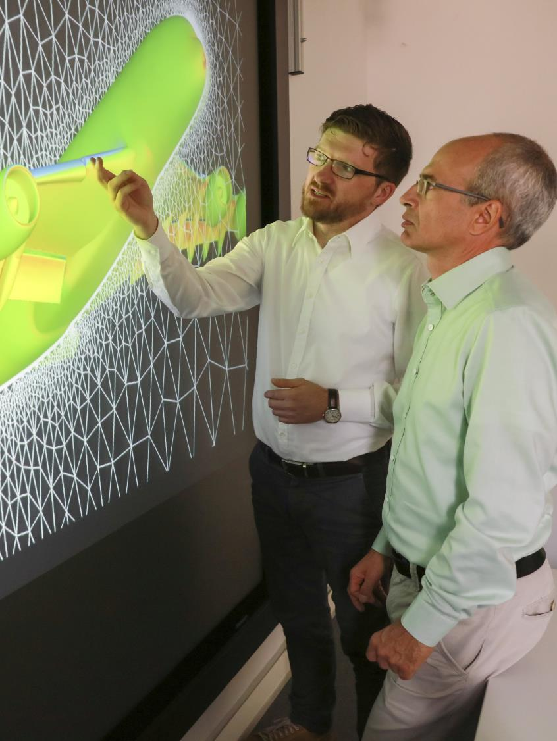
Research and innovation at a glance
© DAAD/Focke Strangmann
Among the world’s innovation leaders
Germany is the 3rd largest economy in the world
Approx. €135bn for R&D: no other country in Europe invests more in research and development
Patents: Germany ranks 5th in terms of international patent applications (PCT)
Germany is the top participating country in the Horizon Europe programme
Notes:
Germany is one of the world’s most innovative countries:
Germany is the 3rd largest economy in the world (behind USA and China). In 2025, it’s nominal GDP was $4.7 trillion (USA: 30,5 trillion; China: 19,2 trillion).
With R&D spending of approx. €135bn in 2024, Germany leads the field in Europe. It is also one of the countries worldwide that invest the most in research and development (4th place after the USA, China and Japan in 2023).
Germany is also one of the leading countries in terms of international patent applications (PCT), ranking 5th in 2024 (after China, the USA, Japan, South Korea); in this category it occupies the top spot in Europe.
More than 2,500 German institutions are involved in over 4,500 Horizon Europe research projects, and as a result are internationally networked in all the thematic areas and tools of this framework programme. Germany has so far received €5.4bn from the programme (as of June 2024).
Sources:
Wikipedia; International Monetary Fund (IMF)
Federal Statistical Office
Eurostat
OECD: MSTI
WIPO: PCT Yearly Review 2025
Deutscher Bundestag DS 21/3350

Slide 4
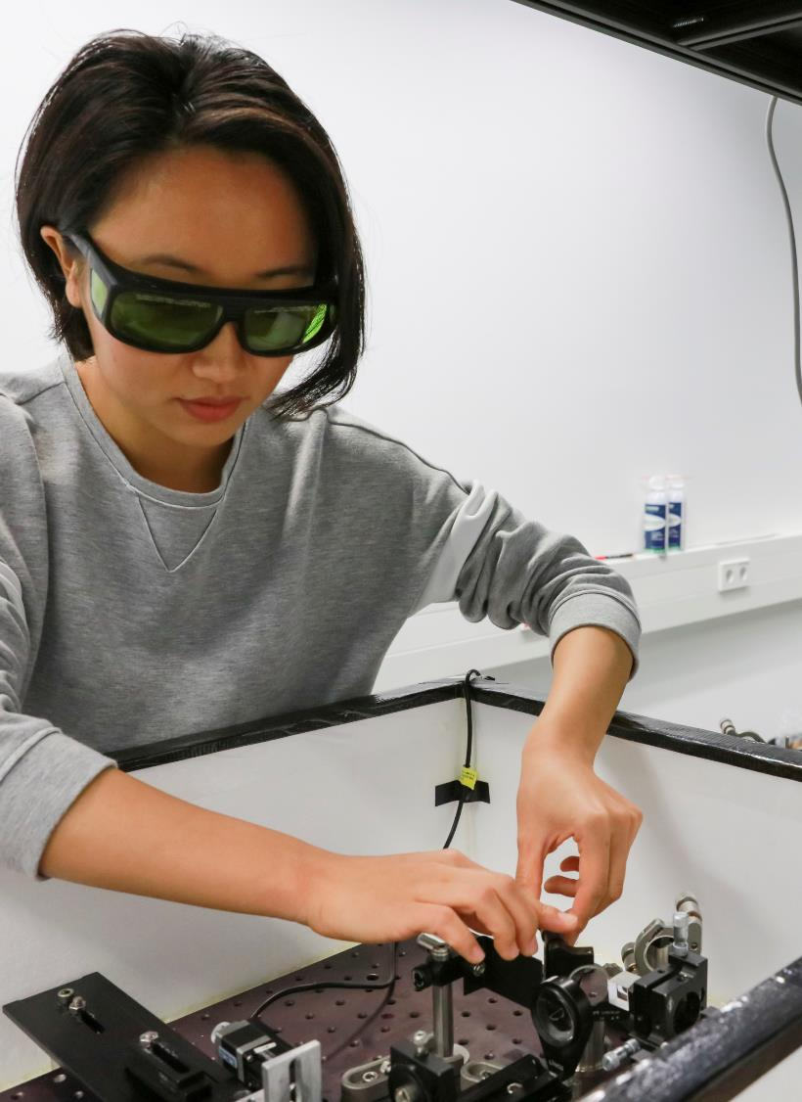
Research and innovation actors
Companies and start-ups
Higher education institutions (HEIs)/universities
Non-university and government research institutions
Clusters/research alliances
Private sector research institutions
© DAAD/Focke Strangmann
Notes:
Germany is one of the world’s most research-oriented and innovative economies. The basis for this is an efficient system of research and innovation in which actors and funding frameworks are perfectly matched to one another:
Research and development (R&D) is conducted for the most part in private companies.
R&D is also pursued at a large number of public and private institutions, however:
universities
non-university research institutions and academies
federal and state-level research departments
are the main pillars of public research in Germany.
Other important actors:
clusters and research alliances between companies, universities, research institutions and other public institutions
research organised by the private sector (e.g. Zuse-Gemeinschaft)
Funding comes primarily from
business and industry,
Germany’s Federal government,
the 16 state-level governments and
the European Commission.
In addition, R&D is also funded by public and private foundations.
The most important of these actors are presented on the following slides.
Source: BMFTR: Federal Report on Research and Innovation (BuFI)

Slide 5
Innovative Germany
Innovation actors
Key facts – companies and start-ups
Approx. 543,500 people working in R&D, including 313,000 researchers
64,500 innovation and growth-oriented start-ups
Approx. 32,500 R&D companies
69% of R&D investments in Germany
Notes:
Research and development activities are pursued for the most part in companies and largely funded by business and industry itself (69 per cent of R&D investments in Germany in 2023). A significant part of this R&D is done by large companies that operate internationally. Nonetheless, SMEs and start-ups likewise play an important role because in many cases they are the ones that produce ground-breaking innovations.
According to the Stifterverband, there are around 32,500 research companies, employing almost 313,000 researchers (2023, FTE).
Innovative start-ups
Start-ups are commercial enterprises no more than 5 years old that conduct R&D to prepare a technological innovation for the market, or at least that offer a product or service that is new to the German market.
According to KfW, there were around 64,500 such new innovation-oriented start-ups in 2024.
Sources:
BMFTR: Federal Report on Research and Innovation (BuFI)
Research companies: Stifterverband: Methodenbericht (2025)
R&D (personnel): Stifterverband: Zahlenwerk 2025
R&D personnel: BMFTR's Data portal
Start-ups: KfW Entrepreneurship Monitor 2025

Slide 6
Innovative Germany
Innovation actors
Key facts – higher education institutions (HEIs)/universities
Approx. 159,000 people working in R&D, including 123,000 researchers
Around 3,000 academic spin-offs founded in 2023
Almost 26,000 European patent applications (2000–2020)
€23.0bn internal expenditure on R&D
Notes:
Higher education institutions/universities
The wide-ranging higher education landscape is a central element of the German research and innovation system. The spectrum extends from basic research to applied research and development for business and industry. Universities spent approx. 23 billion euros on R&D in 2023.
Universities also account for a large proportion of the people and researchers working in R&D. Of the 486,000 or so researchers in R&D nationwide, more than 1 in 4 (123,000) work at universities (2022).
According to the European Patent Office, Germany is the leader by number of academic patents generated by domestic universities (2000–2020).
Spin-offs
Besides teaching and research, knowledge transfer is another important job for the science and higher education system. Technology-oriented and knowledge-based spin-offs play a key role in the transfer of technologies and research findings from science to industry. Around 3,000 academic spin-offs are founded in 2023. (See also slide further below).
Sources:
Federal Statistical Office
R&D personnel: BMFTR's Data portal
Spin-offs: Stifterverband: Gründungsradar 2025
Patents: European Patent Office

Slide 7
Innovative Germany
Innovation actors
Key facts – non-university and government research institutions
Approx. 121,000 people working in R&D, including 64,500 researchers
More than 18,000 European patent applications (2000–2020)
Including 181 research institutions run by the federal and state governments
Around 1,000 public and publicly funded research institutions
€18.6bn internal expenditure on R&D
Notes:
Approx. 1,000 public and publicly funded institutions for science, research and development (2023), including
federal, state-level and municipal research institutions,
the leading non-university research institutions: Helmholtz Centres, Max Planck and Fraunhofer institutes, and institutions of the Leibniz Association
academies
scientific libraries and museums
legally independent institutes at universities
Non-university and government research institutions spend 18.6 billion euros on R&D in 2023, employing almost 121,000 staff in R&D (2022, FTE).
The federal and state-level research institutions are important components of the German research and innovation system. They explore topical social and policy-specific issues in order to support political action. On the basis of scientific facts, they serve as bridge builders between science and policy, innovation and application.
The non-university research institutions are a special feature of the German research and innovation system. They are jointly funded by the federal and state governments and in some cases boast internationally unique research infrastructures and large-scale equipment. As the cornerstone of public research, they cover the entire spectrum from excellent basic research to socially relevant and application-oriented research.
According to the European Patent Office (EPO), Germany ranks second in terms of the number of patents generated by public research organisations at the EPO (2000–2020).
In the European Research Centre Spinout Ranking, the major German non-university research institutions Max Planck Society, Helmholtz Association, Fraunhofer and Leibniz Association, as well as the German Aerospace Centre, are among the top 20 European research centres for deep tech & life science (2025).
Sources:
Federal Statistical Office
BMFTR: Federal Report on Research and Innovation (BuFI)
R&D personnel: BMFTR's Data portal
Spinouts: European Spinouts Report 2025
Patents: European Patent Office

Slide 8
Innovative Germany
Innovation actors
Key facts – clusters/research alliances
Ranked 3rd among the Top 100 innovation clusters worldwide in the GII
Including 12 leading-edge and 14 Clusters4Future
Ranked 7th worldwide in terms of innovation linkages (GII)
475 regional clusters
Notes:
475 regional clusters are registered on the German government’s cluster platform in 2026, including 12 leading-edge (e.g. it's OWL, digital and sustainable transformation of SMEs) and 14 Clusters4Future (e.g. MCube, mobility transition) – the winners of the respective funding competitions in recent years.
Clusters are cooperative ventures between companies, universities, research institutions and other public institutions in related industries or technologies that complement each other through collaborative interaction and activities along value chains.
The key defining criteria are
the regional proximity of the actors,
a sufficient number and density of companies and research institutions,
thematic-market proximity and
at least national sales potential of the products and services.
In the individual indicators tracked by the Global Innovation Index (GII), Germany currently scores particularly well for the innovation clusters, among others:
With seven well developed regional clusters, Germany ranks 3rd after China and the USA in terms of the number of Top 100 innovation clusters, 2025.
The largest clusters in Germany are to be found in the Munich (27th), Berlin (30th) and Colonge (43rd) regions.
Germany ranks 7th worldwide in terms of innovation linkages (e.g. R&D cooperation between companies, universities and research institutions).
Sources:
BMWE; BMFTR: Clusterplattform Deutschland
World Intellectual Property Organization (WIPO): Global Innovation Index 2025

Slide 9
Innovative Germany
2025: a new record in start-ups
3,568 start-ups founded in 2025 – a 29% increase over 2024
Strongest sector is software followed by medicine and food
Excellent research as driving force
New start-up and scale-up strategy adopted in January 2026
203
70
19
17
619
168
33
73
658
247
27
120
79
22
785
428
Notes:
This trend in new business start-ups is evident across the country. Entrepreneurial spirit and enthusiasm to innovate are not confined to just a few metropolitan areas, but are increasingly emerging in many regions of Germany.
Bavaria, North Rhine-Westphalia, and Saxony recorded particularly strong growth.
In January 2026, the Federal Government adopted a new start-up and scale-up strategy. It aims at key aspects such as improving financing conditions, reducing bureaucracy, and attracting talent.
Sources: German Startup Association, Federal Ministry of Economic Affairs and Energy

Slide 10

Notes:
The High-Tech Agenda Germany is the German government’s latest innovation initiative. It aims at competitiveness, value-creation and sovereignty through research and technology.
Source:
Federal Government - https://hightech-agenda-deutschland.de/en/

Slide 11
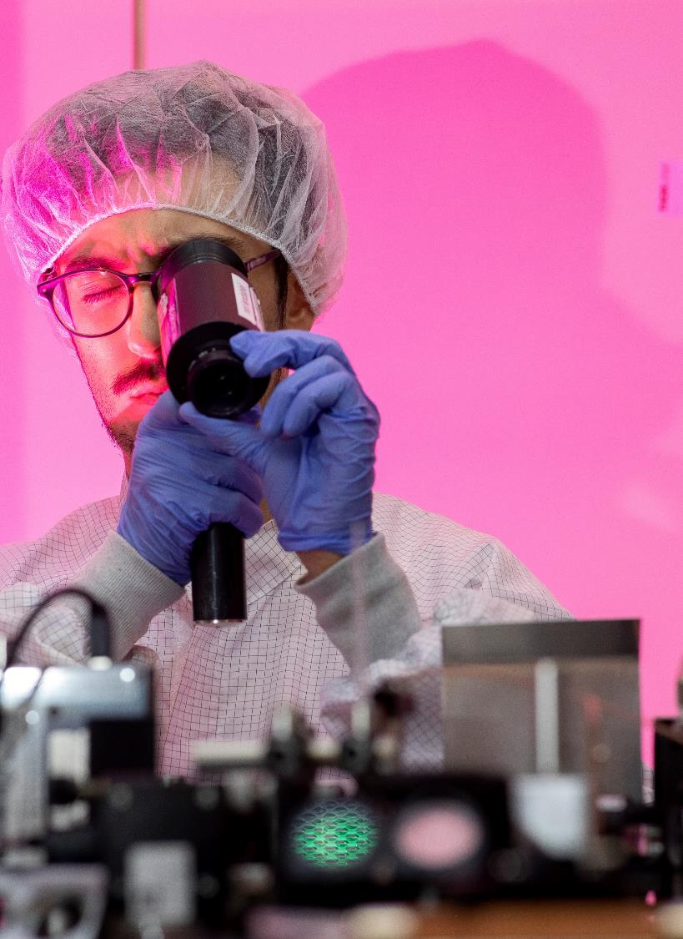
High-Tech Agenda Germany
Goals
strengthen Germany’s innovation and economic power
position Germany at the forefront of global technological competition
focus on six key technologies and five strategic research fields
establish detailed roadmaps for each key technology
© DAAD/Jan Zappner
Notes:
The High-Tech Agenda Germany aims to significantly enhance the country’s innovation and economic power by intensifying investments in future technologies. It focuses on six selected key technologies and five strategic research fields. The overarching goal is to catapult Germany back to the forefront of international technological competition.
Source: BMFTR

Slide 12

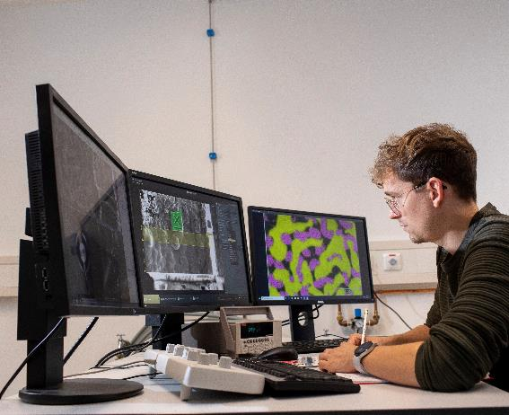
© DAAD/Jan Zappner
High-Tech Agenda Germany
© DAAD/Jan Zappner
6 key technologies
Artificial intelligence
Quantum technologies
Microelectronics
Biotechnology
Fusion and climate-neutral energy
Technologies for climate-neutral mobility
5 strategic research fields
Aerospace research
Health research
Security and defence research
Marine, climate and sustainability research
Social sciences and humanities
Notes:
The High-Tech Agenda Germany drives innovation through six key technologies: artificial intelligence, quantum technologies, microelectronics, biotechnology, fusion and climate-neutral energy, and technologies for climate-neutral mobility.
It also focuses on five strategic research fields: aerospace research, health research, security and defence research, marine, climate and sustainability research, and the humanities and social sciences.
Together, these areas strengthen Germany’s technological leadership and its contribution to a sustainable, secure future.
Source: BMFTR

Slide 13
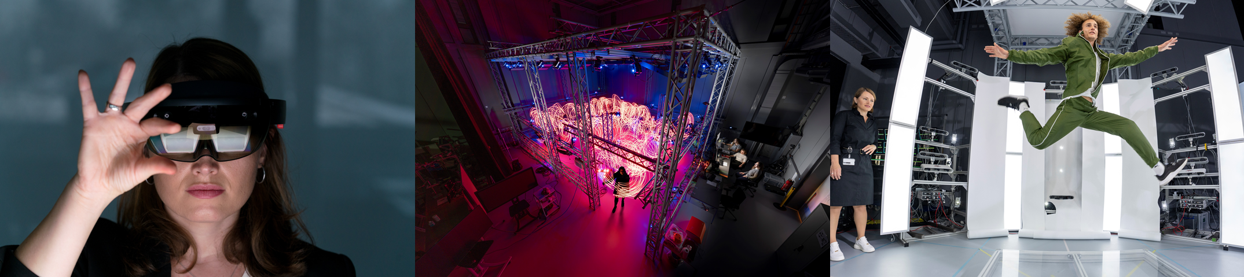

© Max Planck Institute for Intelligent Systems
High-Tech Agenda Germany
Key technology: artificial intelligence
Case study: Cyber Valley – Europe’s largest AI research consortium
Partners from
Universities and research institutes
Automotive and tech industry
Public administration
Topics
Intelligent systems and robotics
Machine learning
Computer vision
From research to application
Talents & start-up culture
cyber-valley.de
Notes:
Cyber Valley is Europe’s largest research cooperation in the field of artificial intelligence (AI) and modern robotics. It includes partners from research, industry, public administration and society.
The partners believe that AI should be developed and used responsibly. It should be embedded in open societies allowing for critical and evidence-based public debates. Therefore, the Cyber Valley builds bridges curiosity-driven basic research and applied research. Furthermore, it has a strong focus on talent development and promotes a start-up culture among scientists to enable a quick knowledge and technology transfer from science to application.
Source: https://cyber-valley.de

Slide 14
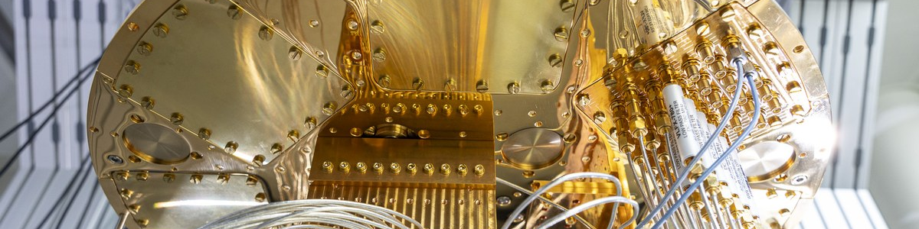
© FZ Jülich / Sascha Kreklau
High-Tech Agenda Germany
Key technology: quantum technologies
Case study: JUelich Quantum Computing Alliance (JUQCA)
A hot-spot for quantum research in Europe – from fundamental science to applications
Full stack quantum computer systems development including hardware, software, and applications
JUNIQ infrastructure offers access to various quantum systems for science and industry
Renowned industrial partners
Involved in major national and international projects and networks (e.g. QSolid, EU Quantum Flagship)
Talent promotion and knowledge transfer (spin-offs, young talent groups, postdoc office)
fz-juelich.de
Notes:
Renowned industrial partners such as Ndivia, Infineon or Mercedes-Benz
Involved in national and international key projects and networks
QSolid: a national flagship project of 26 partners of which 52% are from industry and a total budget of 76,3 million euro (2022-2026)
EU Quantum Flagship: a long-term EU research initiative with a budget of 1 billion euros (2018-2028)
Source: FZ Jülich

Slide 15


© Fraunhofer EMFT
High-Tech Agenda Germany
Key technology: microelectronics
Case study: Research Fab Microelectronics Germany (FMD)
Cooperation of 15 highly specialised institutes and 13 cleanrooms equipped with cutting-edge technology
A one-stop-shop for micro- and nanoelectronics that offers customised solutions along the entire value chain
Implements the APECS Pilot Line for Advanced Packaging and Heterogeneous Integration to bridge the gap between research and industry
Hosts the German Chips Competence Centre (G3C) that connects innovators with APECS and other European pilot lines
forschungsfabrik-mikroelektronik.de | apecs.eu | german-chips.de
Notes:
The Research Fab Microelectronics Germany (FMD) is one of the key stakeholders within the German microelectronics ecosystem.
• Cooperation of 15 highly specialized institutes and 13 cleanrooms equipped with cutting-edge technology
• As a one-stop shop, FMD offers customized solutions from a single source along the entire value chain by combining the excellent technologies and system solutions of its institutes
• As part of the EU Chips Act, FMD is implementing the APECS Pilot Line for Advanced Packaging and Heterogeneous Integration, bridging the gap between research and industry
• The German Chips Competence Centre (G3C), hosted by FMD, connects innovators with the infrastructure of the APECS pilot line and other European pilot lines
Source: Research Fab Microelectronics Germany (FMD)

Slide 16
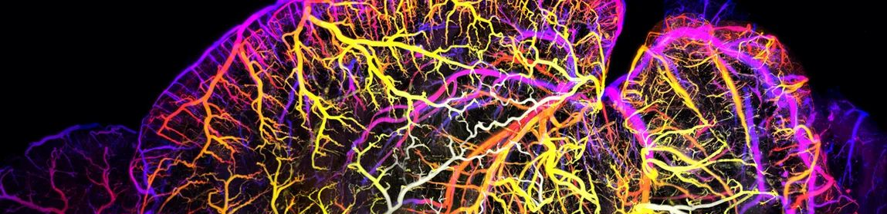
© Helmholtz Association / Ali Ertürk
High-Tech Agenda Germany
Key technology: biotechnology
Case study: Helmholtz Munich – where biomedical research meets technological innovation
Six research centres covering e.g. computational health and biology, bioengineering, stem cells, and environmental health
Strong focus on AI and machine learning (e.g. in diagnostics, single-cell genomics, etc.)
Innovation campus “Helmholtz Pioneer Campus”
Technology transfer
Public engagement
helmholtz-munich.de
Notes:
With advanced technological capabilities come new opportunities to better understand and treat diseases. This mission lies at the heart of the research conducted at Helmholtz Munich. Taking an interdisciplinary and international approach, Helmholtz Munich develops and applies new biotechnological tools and methods, working closely with partners to translate research into real-world applications.
Source: Helmhotz Munich

Slide 17
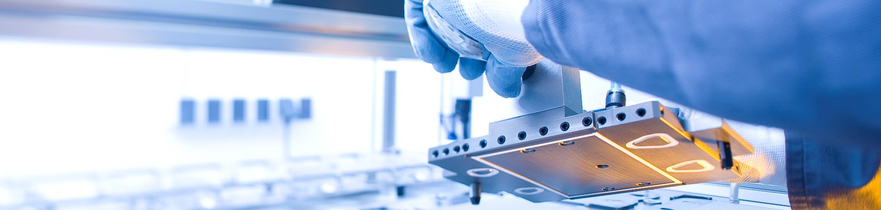

© Energy Saxony e.V.
High-Tech Agenda Germany
Key technology: fusion and climate-neutral energy
Case study: Energy Saxony
Cluster actors
SMEs
Large companies
Universities
Research institutions
Actors from politics
Topics
Decarbonisation, especially hydrogen technologies
Energy storage
Circular economy
Grid transformation
energy-saxony.net
Notes:
To bring about a sustainable transition in the economy and society, a transition is also needed in the area of energy supply, especially in terms of increased energy efficiency and sustainability.
The Saxony-based energy and environmental technology cluster Energy Saxony is working on this.
Energy Saxony is a network of companies and research institutions in the state of Saxony.
The cluster’s goal is to
create innovative and cross-sectoral infrastructures for a sustainable, resource- and climate-friendly energy supply, and to contribute
to the heat and mobility transition and
to establishing a green economy with circular economy components.
The network pools in particular competencies in zero-emission technologies and green hydrogen.
Source: www.energy-saxony.net

Slide 18
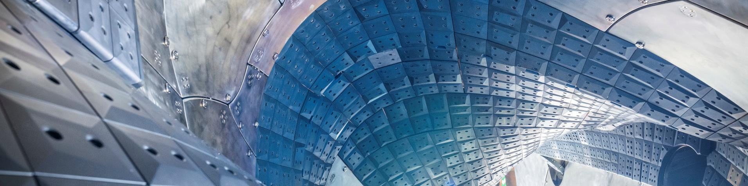
© Max Planck Institute for Plasma Physics
High-Tech Agenda Germany
Key technology: fusion and climate-neutral energy
Case study: Action Plan for the world’s first fusion power plant in Germany
8 action areas and measures
Strengthen research funding
Build a fusion ecosystem
Research infrastructures and technology demonstrators
Skills, training and education
Involve and engage the public
Legal framework (regulation under the Radiation Protection Act)
IPR and Standardisation
Strategic international cooperation
Notes:
In 2025, Germany‘s goverment adopted an action plan for the world’s first fusion power plant in Germany. An industry-led consortium is to build the power plant. It will include start-ups, established companies from the industry, and representatives from the scientific community. Until 2029, investments of more than 2 billion Euros for fusion research are foreseen.
The action plan includes 8 action areas and measures to pave the way toward a fusion power plant in Germany.
Source: Federal Ministry of Research, Technology and Space

Slide 19


© DLR (CC BY-NC-ND 3.0)
High-Tech Agenda Germany
Key technology: technologies for climate-neutral mobility
Case study: MCube
Stakeholders from
Science
Public sector
Business
Society
Topics
Mobility transition
Mobility innovations
Participatory experiments in real laboratories
mcube-cluster.de
Notes:
The transformation of the mobility system requires climate-friendly, environmentally compatible, barrier-free and socially just mobility solutions. One of the 14 Custers4Future to be awarded excellence status so far is working on this: the Munich Cluster for the Future of Mobility in Metropolitan Regions (MCube).
Its goal, together with partners from science, business, the public sector and society in the Munich region, is to drive forward the sustainable design of mobility in metropolitan regions like Munich and to create holistic mobility innovations for urban spaces.
The cluster is coordinated by the Technical University of Munich.
Source: www.mcube-cluster.de

Slide 20

© DLR (CC BY-NC-ND 3.0)
High-Tech Agenda Germany
Strategic research field: aerospace
Case study: German Aerospace Center (DLR)
The main German hub for research and innovation in aeronautics and space
Covering R&D in aeronautics, space, energy, transport, and security
Hosts the new Space Innovation Hub, the central platform that links the space industry and the public sector
30 sites and 51 institutes across Germany, international offices in Brussels, Paris, Tokyo and Washington D.C.
dlr.de
Notes:
Sources: DLR, Space Innovation Hub

Slide 21
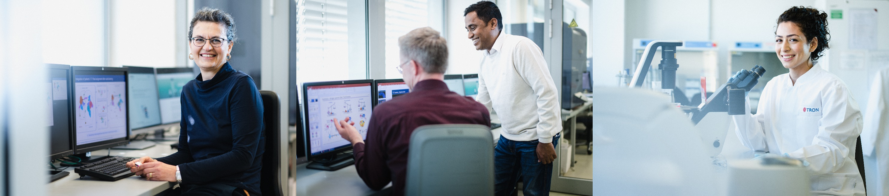

© TRON GmbH
High-Tech Agenda Germany
Strategic research field: health
Case study: Cluster for atherothrombosis and individualised medicine (curATime)
Almost 30 cluster actors, including
Universities and research institutions
SMEs and large companies
Networks
Foundations
Public administration
Topics
Multidimensional data from large population and patient cohorts
AI-based identification of disease-associated risk profiles
Issue-specific mRNA therapy
curatime.org
Notes:
The cluster curATime is one of the large Clusters4Future which the Federal Ministry of Research, Technology and Space is funding. curATime is based in the Rhine-Main-Palatinate region. The partners develop individualised therapies against atherothrombosis with the help of new research approaches, technologies such as mRNA technology and artificial intelligence.
The cluster brings together some of the world’s leading universities, research institutes and companies in the areas of biotechnology and health.
Sources:
www.clusters4future.de
https://curatime.org

Slide 22


© Pixabay / Hans
High-Tech Agenda Germany
Strategic research field: marine, climate and sustainability
Case study: BioökonomieREVIER
Around 60 partners, including
Research institutes and universities
Companies and business associations
Cities and municipalities
Topics
Model region for sustainable and circular bioeconomy
Innovative food systems
Biological transformation of industrial production
biooekonomierevier.de
Notes:
The goal of BioökonomieREVIER is to actively shape the green transition of the Rhenish lignite mining area towards a circular, sustainable bioeconomy model region. The aim is to compensate for the consequences of the lignite phase-out in 2030 and the associated job losses. The BioökonomieREVIER develops and demonstrates circular value chains and climate-neutral, resource-efficient, and bio-based business models in the region through targeted transformation management. Further measures are implemented in the fields of qualification, regional development, and knowledge transfer to society.
The BioökonomieREVIER is lead by the Institute of Bio- and Geosciences at Forschungszentrum Jülich, a world leading research institute i.a. in the area of plant and crop sciences.
Sources:
www.biooekonomierevier.de
FZ Jülich, IBG-2: https://www.fz-juelich.de/en/ibg

Slide 23
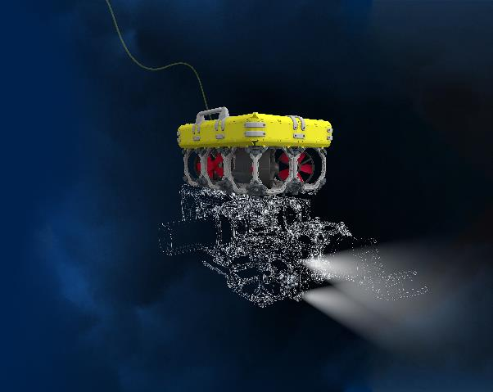
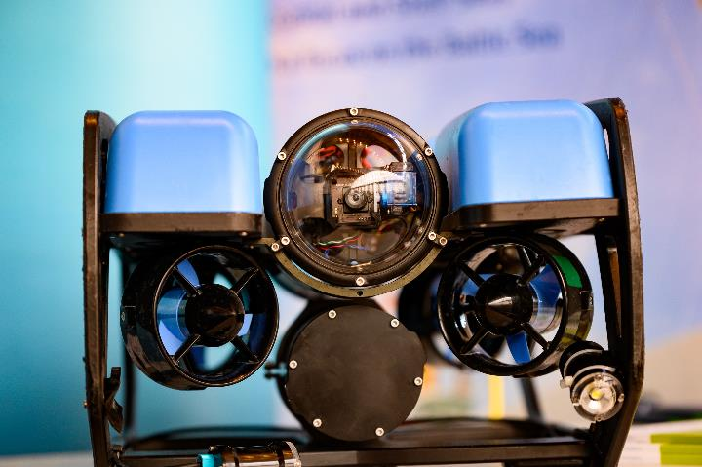
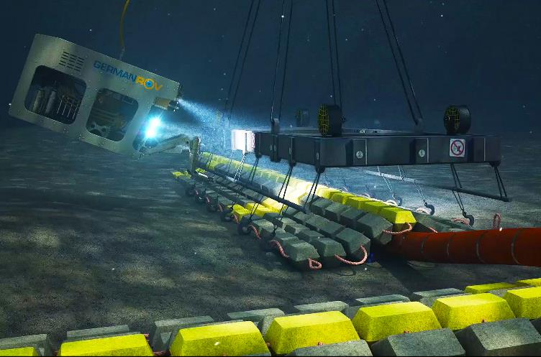

© Fraunhofer IGD
High-Tech Agenda Germany
Strategic research field: marine, climate and sustainability
Case study: Ocean Technology Campus Rostock
36 cluster actors, including
SMEs and Start-ups
Large enterprises
Universities and research organisations
Topics
Subsea mobility & autonomy
Digital technologies
Ocean lense (monitoring)
Sustainable ocean use
Ocean open innovation
oceantechnologycampus.com
Notes:
Oceans cover more than two-thirds of the Earth’s surface. They moderate our climate and provide habitat for countless species, but also food, energy and raw materials. The sustainable use of the ocean ecosystem is thus of utmost importance for our life on Earth.
The Ocean Technology Campus (OTC Rostock) is located in the city of Rostock is an internationally leading center which focusses on novel underwater technologies to reconcile ecology and economy in order to achieve a more sustainable use of the oceans.
Sources:
www.oceantechnologycampus.com
www.clusters4future.de

Slide 24


© Unsplash / Eryka Rose Raton
High-Tech Agenda Germany
Strategic research field: social sciences and humanities
Case study: Weizenbaum Institute
Interdisciplinary research on the digitalised and networked society
Knowledge transfer to politics, business and civil society
Founded in 2017, supported by a research network of universities and research institutes
Named after the German-American computer science pioneer Joseph Weizenbaum
weizenbaum-institut.de
Notes:
Strengthening the Weizenbaum Insitute is among the key measures of the High-Tech agenda Germany in the strategic research field social sciences and humanities.
The Weizenbaum Institute is a research institute that conducts interdisciplinary research on the digitalized and networked society. It covers crucial research areas as well-being, participation and democracy in the digital world, the change of work trough digital technologies such as AI in particular or the role of digital platforms for markets and societies.
It has a strong focus on knowledge transfer to politics, business and civil society.
Founded in 2017, the Weizenbaum Institute is supported by a research network of universities and research institutes from Berlin and Brandenburg: e.g. universities from Berlin and Potsdam, Fraunhofer Institute for Open Communication Systems (FOKUS) and the Berlin Social Science Center (WZB).
The institute is named after the German-American computer science pioneer and critic Joseph Weizenbaum (1923 – 2008) who emigrated from Germany to the USA where he studied mathematics and later became a professor for computer science at the MIT.
Sources: Hightech Agenda Germany, Weizenbaum Institute

Slide 25
Innovative Germany
© DAAD/Volker Lannert
Knowledge and technology transfer
Notes:
The science and higher education system has an important responsibility alongside teaching and research, namely the transfer of knowledge. This involves new knowledge generated by research – which is publicly funded – being passed on in a systematic and targeted manner to society; this also encompasses new technologies. The Federal Government is aiming to boost this transfer process with a wide range of funding programmes and initiatives.

Slide 26
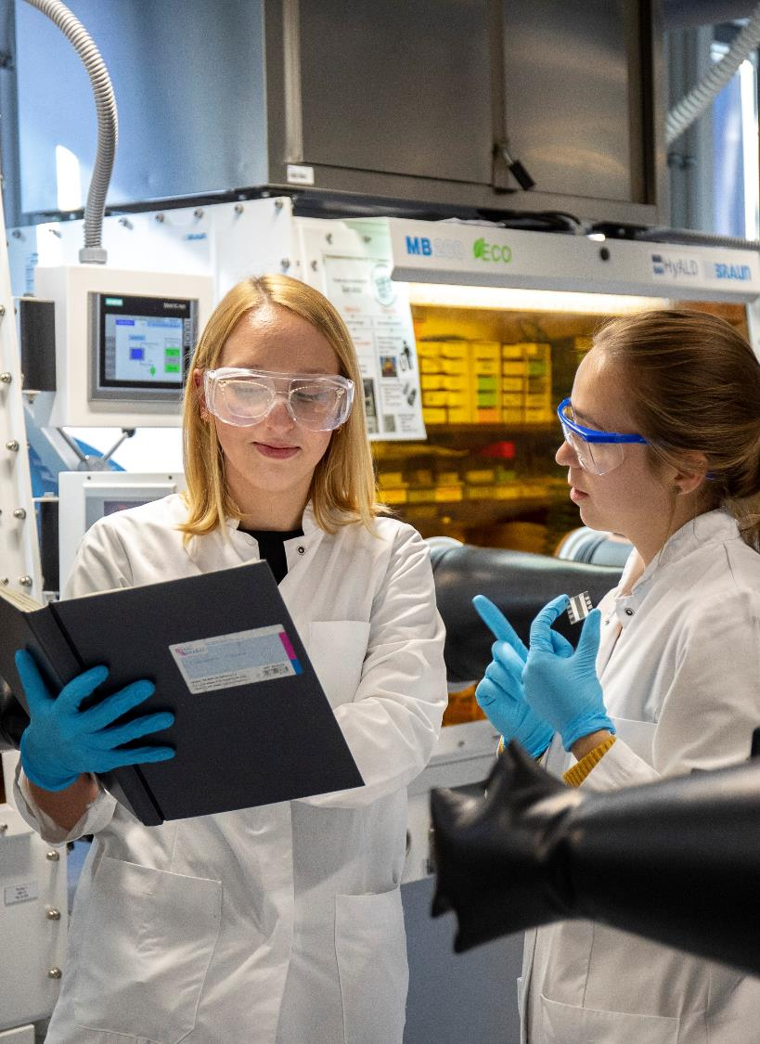
Knowledge and technology transfer
Actors
Universities/higher education alliances
Research institutions
Clusters
Scientific spin-offs
Innovation alliances
© DAAD/Jan Zappner
Notes:
The results of scientific research form the basis for new products, services and processes. To develop and implement viable solutions and to increase value-adding and competitivity, the German government supports the transfer of technology and knowledge from research:
One key transfer instrument involves funding joint projects, i.e. cooperation between universities/research institutions and business/industry
Targeted support is provided to establish transfer structures including clusters, competence networks and research and innovation labs, e.g. Medical Valley EMN (European Metropolitan Region of Nuremberg). Medical Valley EMN is a leading-edge cluster of research institutions and internationally prominent and upcoming companies, as well as a world-class healthcare cluster.
Technology-oriented and knowledge-based spin-offs from universities and non-university research institutions are important drivers of innovation in Germany. One prime example is BioNTech, a spin-off from Johannes Gutenberg University Mainz that developed the first mRNA vaccine against SARS-CoV-2 to be granted approval in line with international standards
There are also innovation transfer alliances at the federal state level, e.g. the Innovationsallianz Baden-Württemberg (innBW). It is an alliance of 12 non-university application-oriented research institutions aimed at the transfer of findings from basic research to industrial practice.
Sources:
www.medical-valley-emn.de
https://presse.uni-mainz.de
www.innbw.de/de/innbw

Slide 27
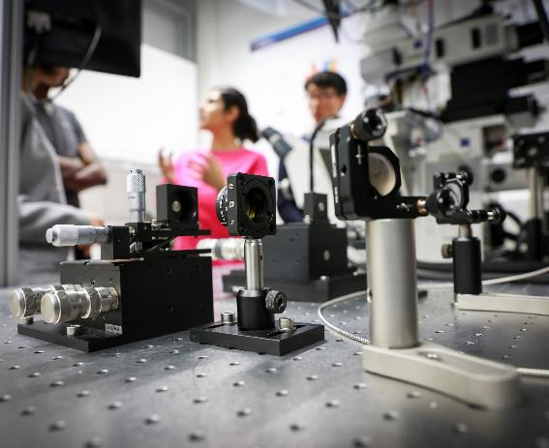
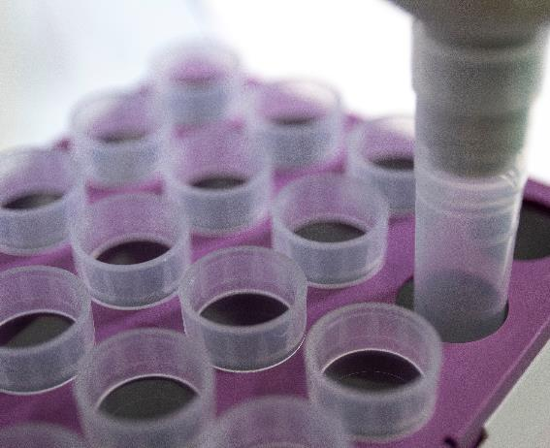
© DAAD/Focke Strangmann
Knowledge and technology transfer
Funders of innovation
Start-up incubators at higher education institutions and non-university research institutions
Federal innovation agencies
Federal and state ministries
Innovation funding agencies in the federal states
Regional associations
© DAAD/Jan Zappner
Notes:
By international standards, Germany boasts an extremely broad and nuanced system of funding instruments.
Start-up incubators at higher education institutions and non-university research institutions:
Many higher education institutions and universities have transfer departments responsible for cooperation with companies and the establishment of spin-offs.
One example is the renowned Karlsruhe Institute of Technology (KIT), which results in 30 spin-offs per year. It supports spin-offs via its Gründerschmiede (start-up incubator), and through its Innovation and Relations Management service unit helps industry and investors access new knowledge, innovative technologies and research results that are close to market readiness.
The four biggest non-university research institutions funded by the federal and state governments – Fraunhofer, Max Planck Society, Helmholtz Association and Leibniz Association – have a large number of their own programmes to support innovative and technology-oriented start-ups.
Federal innovation agencies:
Funding of technologies with groundbreaking innovation potential is provided by
the Federal Agency for Breakthrough Innovation (SPRIND) and
in the case of cybersecurity by the Agentur für Innovation in Cybersicherheit (Die Cyberagentur)
Federal ministries:
The Federal Ministry for Economic Affairs and Energy (BMWE) funds technology-oriented spin-offs and entrepreneurship at higher education institutions and non-university research institutions via EXIST, a funding programme which supports university graduates, scientists and students in preparing their technology-oriented and knowledge-based start-ups. It is not restricted to any one specific type of technology.
The Federal Ministry of Research, Technology and Space (BMFTR) supports technology-based spin-offs within the framework of its specialist programmes. Funding encompasses the pre-launch phase at the scientific institution and the subsequent start-up phase.
In addition, there are funding programmes and innovation funding agencies run by the state governments, such as the North Rhine-Westphalia state government, which has various funding programmes and provides advice and support to anyone interested (e.g. NRW.innovativ).
Funding structures also exist at the regional level such as the Hydrogen Metropole Ruhr, which coordinates and supports the hydrogen activities of the Ruhr region.
Sources:
https://kit-gruenderschmiede.de/
https://www.sprind.org
https://exist.de
https://www.cyberagentur.de
https://nrwinnovativ.de
https://hydrogen.ruhr

Slide 28
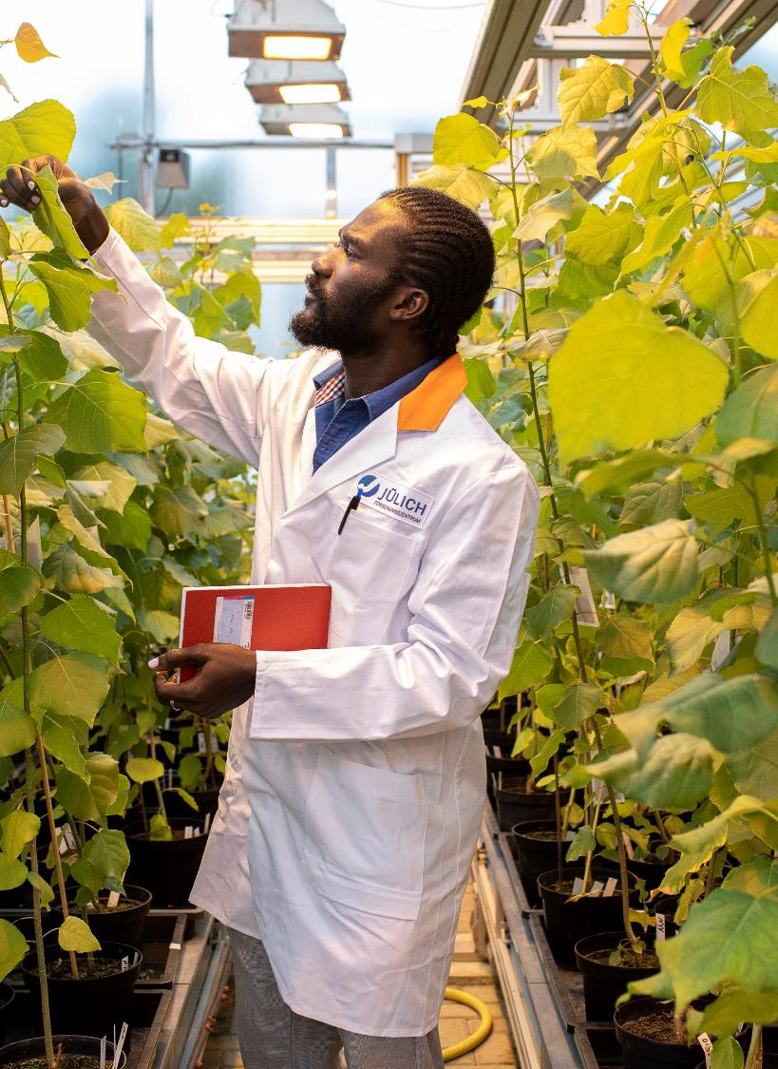
Knowledge and technology transfer
Main funding programmes open to international partners
Eureka and Eurostars
ZIM international cooperation
Collective Research Networking
Multilateral and bilateral thematic calls of federal ministries
SPRIND Challenges
© DAAD/Jan Zappner
Notes:
There are various funding programmes open to international partners, e.g.:
Eureka and Eurostars: The European research initiative Eureka supports the initiation and implementation of application-oriented and cross-border research and development projects. One of its most important programmes is the Eurostars funding programme. It supports companies and scientific institutions with implementing cross-border and market-oriented research collaborations on innovative topics, specifically focusing on innovative SMEs.
ZIM international cooperation: The BMWE’s funding programme supports market-oriented technological research and development projects pursued by SMEs in Germany, as well as their cooperation with international partners both in R&D projects and networks.
Collective Research Networking (CORNET): The initiative is a international network of ministries and funding agencies which provides funding for transnational collective research projects and makes international research projects possible for SMEs.
Multilateral and bilateral thematic calls of federal ministries, e.g.:
To implement its National Hydrogen Strategy, the Federal Government runs bi- and multilateral funding measures and initiatives in European countries outside Germany, thereby supporting activities in an international environment. Therefore, the Federal Government created a Hydrogen Guidance Service which gives a compact overview of all the Federal Government’s funding instruments that are to support and promote a swift market ramp-up of hydrogen technologies at national, European and international level.
European and international collaborative research projects for participatory research on securing global food, sustainable forest management and the development of demand-oriented and sustainable solutions are supported by the Federal Office for Agriculture and Food (BLE).
International collaborations in the area of the bioeconomy are supported within the framework of the Federal Government’s National Bioeconomy Strategy.
SPRIND Challenges: The Federal Agency for Breakthrough Innovation SPRIND regularly runs international innovation challenges on future-related topics such as “Anti-Drone Response” or “Next Frontier AI Concepts”. The challenges are open to participants from all over Europe. Through collaborations, partners from around the world can also take part.
Sources:
www.eurekanetwork.org
www.zim.de
https://cornet.online
www.nationale-wasserstoffstrategie.de/en > Funding advice
www.ble.de > Funding measures
https://www.ptj.de/projektfoerderung/biooekonomie
www.sprind.org
www.foerderinfo.bund.de

Slide 29
Knowledge and
technology transfer
Key funding programmes to foster innovation
European programmes
Horizon Europe, e.g.:
  Global Challenges and European Industrial Competitiveness
  EIC programmes
Eurostars
National programmes
ZIM
KMU innovativ
EXIST
HTGF
SPRIN-D
Forschungszulage
Programme run by
federal states (Selection):
Saxony: EFRE/JTF technology funding
Start-up Transfer.NRW
Invest BW – Innovation II
Zentrales Technologie-programm Saar
foerderinfo.bund.de
eubuero.de
Notes:
European funding
As EU member state, Germany participates in the EU Framework Progamme for Research and Innovation Horizon Europe. It is the world’s most generously endowed individual funding programme for research and innovation. Horizon Europe includes numerous innovation funding schemes:
The second pillar of Horizon Europe is dedicated to Global Challenges and European Industrial Competitiveness. This provides funding in particular for projects in the areas of health, culture, creativity and inclusive society, civil security, digital, industry and space, climate, energy and mobility as well as food, bioeconomy, natural resources, agriculture and environment.
The European Innovation Council (EIC), brings key EU instruments such as the EIC Pathfinder, EIC Transitions and EIC Accelerator together under one roof. Besides technological innovations, social innovations or innovations in the service sector can also be supported.
One of the most important European programmes is the EUREKA funding programme Eurostars. It supports companies and scientific institutions with implementing cross-border and market-oriented research collaborations on innovative topics, specifically focusing on innovative SMEs.
The EU Bureau of the BMFTR is the main contact point for questions related to the Framework Programme for Research and Innovation Horizon Europe. It also hosts Germany’s National Contact Points: www.eubuero.de
Important national innovation funding programmes
Central Innovation Programme for SMEs (ZIM) run by the BMWE: funding of market-oriented technological research and development projects pursued by SMEs in Germany
KMU-innovativ: with KMU-innovativ, the BMFTR wants to simplify applications for and approval of funding for SMEs. A central support service provides help with all matters, and binding processing deadlines make for planning security
EXIST: funding for technology-oriented scientific start-ups
High-Tech Gründerfonds (HTGF): funding programme aimed specifically at founders, incl. venture capital investments
Federal Agency for Breakthrough Innovation SPRIND: Funding of technologies with groundbreaking innovation potential
Forschungszulage: Tax-based funding of research and development for companies
In addition, there are numerous regional funding programmes, some of them relating to specific topics, run by Germany‘s federal states, e.g. . Information about these and current funding programmes can be found via the Federal Government’s funding database: www.foerderinfo.bund.de
Sources:
www.eubuero.de
www.horizont-europa.de
https://eic.ec.europa.eu/eic-funding-opportunities_en
www.zim.de
www.bmftr.bund.de > KMU-innovativ
https://exist.de
www.htgf.de
www.sprind.org
www.bmftr.bund.de > Forschungszulage
www.foerderinfo.bund.de

Slide 30
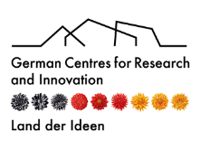



Innovative Germany
International points of contact
German Centres for Research and Innovation (DWIH)
currently 5 locations worldwide
Representationsof German HEIs and research institutions
almost 30 locations worldwide
German Chambers of Commerce Abroad (AHK)
150 locations in over 90 countries
German Trade and Invest (GTAI)
35 locations worldwide
German Accelerator
10 offices worldwide
more than 1,000 mentors worldwide
Representative offices of German universities abroad
Notes:
German innovation actors are represented around the world with offices or points of contact.
Who does what?
DWIH: The German Centres for Research and Innovation are a network of German research organisations, universities and research-based companies. They connect German research with local cooperation partners.
German universities and research institutions have almost 30 representations worldwide.
AHKs: The German Chambers of Commerce Abroad are institutions that promote German foreign trade. Their global network – consisting of bilateral Chambers of Commerce Abroad, delegations and representative offices of German business – advises, supports and represents German companies worldwide that want to establish or expand their foreign business.
GTAI: Germany Trade & Invest is Germany’s foreign trade agency. It also supports foreign companies wishing to locate to Germany.
German Accelerator: German Accelerator supports the most promising German start-ups with their international expansion, providing them with direct access to the global network of partners and investors.
Sources:
www.dwih-netzwerk.de
www.hrk.de
www.ahk.de
www.gtai.de
www.germanaccelerator.com

Slide 31

Innovative Germany
German Centres for
Research and Innovation (DWIH)
DWIH New York
DWIH
San Francisco
DWIH Tokyo
DWIH New Delhi
DWIH São Paulo
dwih-netzwerk.de/en
Notes:
German innovation players are represented worldwide with representative offices, offices, or contact persons. The map shows the locations of the German Centres for Research and Innovation (DWIH).
Source: www.dwih-netzwerk.de

Slide 32

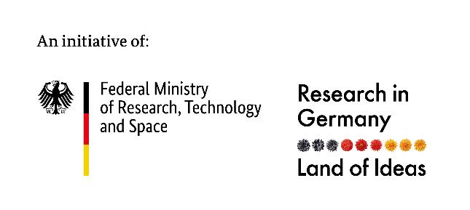
Innovative Germany
Thanks!
Notes:
Thanks for listening!

